Slide 1
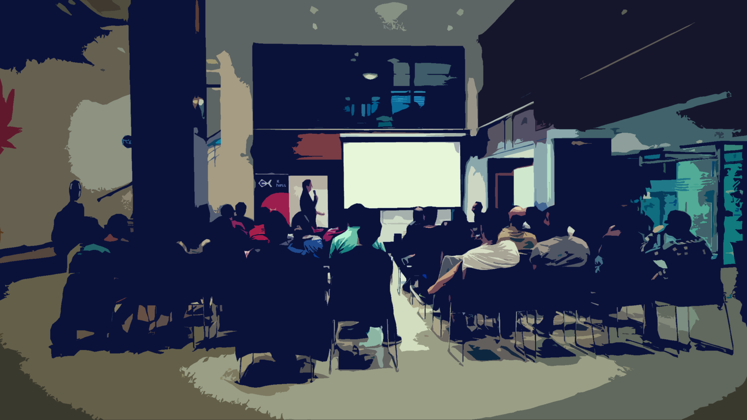
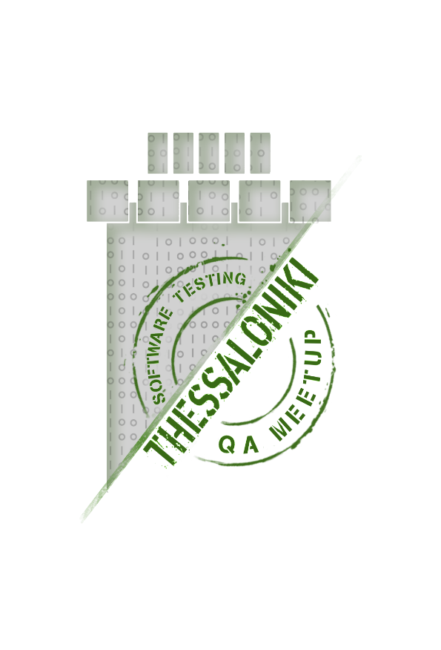







Accessibility Testing , Tools - Automation
John Pourdanis
Our Sponsors :

Slide 2
What accessible means?
Application can be used by people with disabilities like hearing , color blindness , old age etc.
People with disabilities use assistive technology which helps them in operating a software product. Examples of such software are:
Speech Recognition Software - It will convert the spoken word to text , which serves as input to the computer.
Screen reader software - Used to read out the text that is displayed on the screen
Screen Magnification Software- Used to enlarge the monitor and make reading easy for vision-impaired users.
Special keyboard made for the users for easy typing who have motor control difficulties
Our Sponsors :

Slide 3
What is accessibility testing and why we should do it?
Accessibility testing is the testing type that shows how accessible is our software. It’s a subset of usability testing. You can find it also as A11y.
Statistic show that good software products spends 50% of its budget to usability.
Target market for people with disabilities.
Accessibility Legislations for government/banks and many big companies required
Avoid Potential Law Suits (Dominos Pizza)
Covid created the need all people use software.
Care
Our Sponsors :

Slide 4
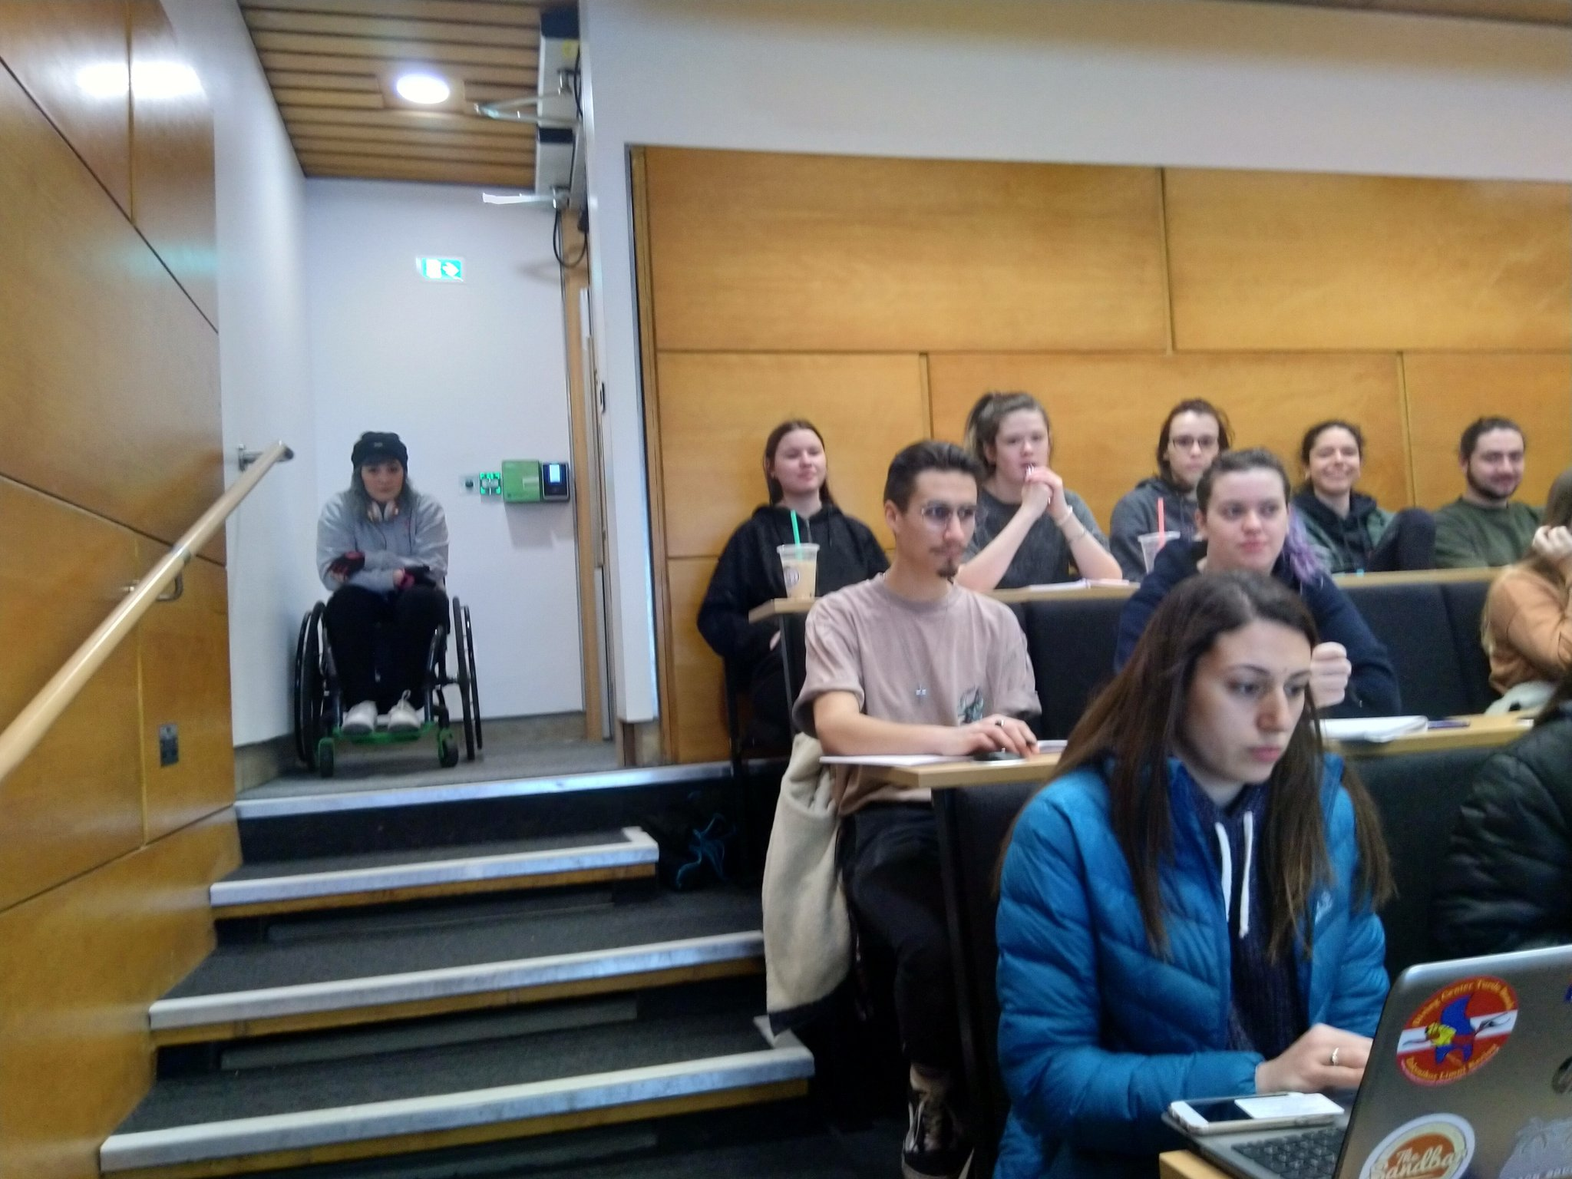
What is accessibility testing and why we should do it?
Our Sponsors :

Slide 5
How we can do it?
1. Manually: You can do manual accesibility checks by e.g removing your mouse and try to access your product.
2. Automated : You can use tools to check your product and give you some recommendations of how you can improve it
3. Automated in your automated tests : Usage of libraries that can integrated with your existing infrastructure of automated tests.
NOTE :Automation is not the silver bullet here , only 20-30% caught by automation.
Our Sponsors :

Slide 6
How accessibility is measured?
Accessibility of the web can be measured with the help of web accessibility standards created by the W3C known as Web Content Accessibility Guidelines (WCAG 2.0, WCAG 2.1)
There are different levels of conformance
Level A (25 criteria)
Level AA (38 criteria)
Level AAA(61 criteria)
Our Sponsors :

Slide 7
How I can start?
Page tittle
Image text alternatives aka "alt text"
Keyboard access with tab order
Contrast ratio of colors
ARIA labels on elements "Accessible Rich Internet Applications"
Use semantic tags like nav, aside, main, section, fieldset, header, footer etc. instead of just using div and span’s.
Use the correct order for headings (h1-h6)
Use button’s for clickables. If a non-interactive element is used for the click event, make sure to add key events for keyboard accessibility.
Associate label with the form control.
Add captions for video and audio..
Our Sponsors :

Slide 8
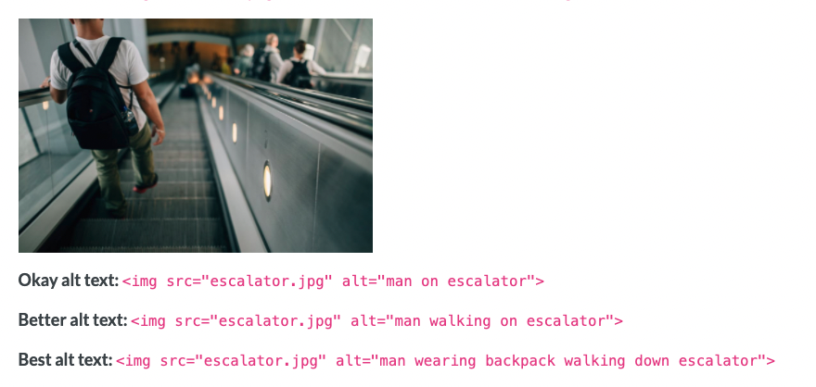
How we can start?
Good practices :
1. Describe the images as specifically as possible
2. Keep it short
3. Don't include "image of" , "picture of"
Our Sponsors :

Slide 9
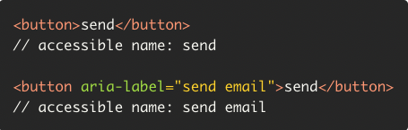
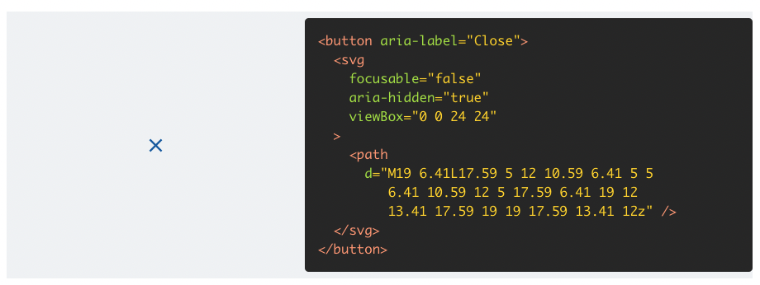
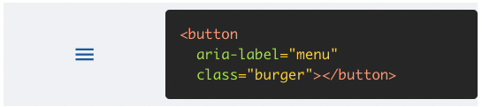
How we can start?
Our Sponsors :

Slide 10
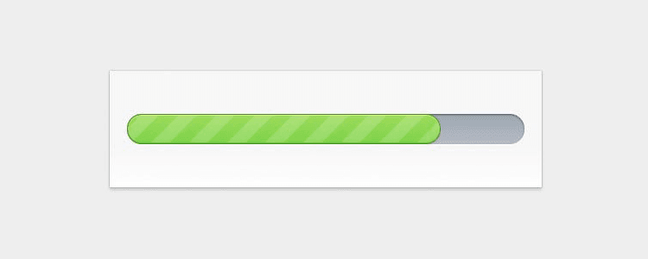
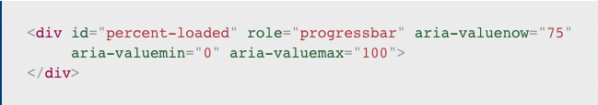
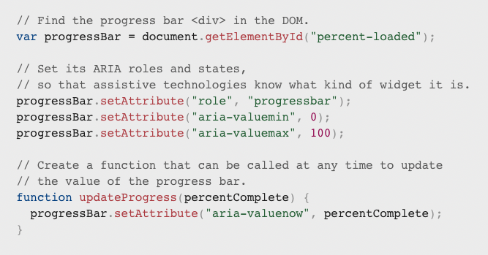
How we can start?
Our Sponsors :

Slide 11
We use Angular/React/Vue or NewFramework.js
Use components that they are accessible e.g material design
Make it as part of DoD of your feature.
Get involved UX guys.
Try to use more of your keyboard to detect issues.
HTML5 native elements are more accessible instead of divs
Focus indicator
Responsiveness
Our Sponsors :

Slide 12
Our Sponsors :

Slide 13
Useful links to start
https://www.w3.org/WAI/test-evaluate/preliminary/
https://developer.mozilla.org/en-US/docs/Glossary/Semantics
https://darekkay.com/blog/accessible-ui-frameworks/
https://wave.webaim.org/
https://webaim.org/resources/contrastchecker/
https://blog.angular.io/accessibility-in-angular-e84f73a223f
https://material.io/design/usability/accessibility.html#understanding-accessibility
Questions?
Our Sponsors :

